Slide 1
Direct Project
November 2010

Slide 2
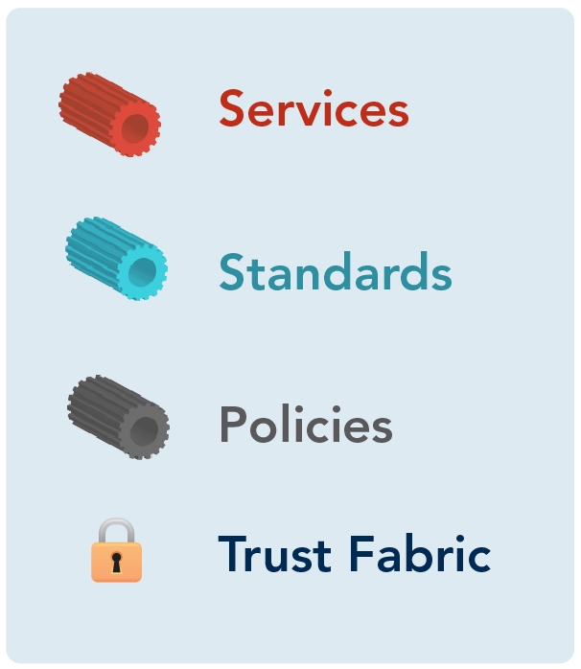
Direct Project What is Direct?
A project to create the set of standards and services that, with a policy framework, enable simple, directed, routed, scalable transport over the Internet to be used for secure and meaningful exchange between known participants in support of meaningful use

Slide 3

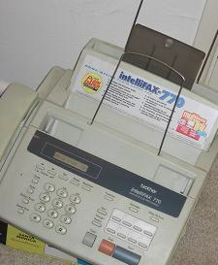

Direct Project Why is there a need for Direct?
When current methods of health information exchange are inadequate:
Communication of health information among providers and patients still mainly relies on mail or fax
Slow, inconvenient, expensive
Health information and history is lost or hard to find in paper charts
Current forms of electronic communication may not be secure
Encryption features of off-the-shelf e-mail clients not often used in healthcare communications today
Physicians need to transport and share clinical content electronically in order to satisfy Stage 1 Meaningful Use requirements.
Need to meet physicians where they are now
Direct will be one of the communication methods in the Nationwide Health Information Network
Notes:
http://www.flickr.com/photos/dougww/922328173/

Slide 4

Direct Project and other Information Exchange
The Direct Project doesn’t replace other ways information is exchanged electronically today, but it might augment them.
The Direct Project supports simple use cases in order to speed adoption, but other methods of exchange might be suited for other scenarios.
The Direct Project was designed to coexist gracefully with existing protocols for data exchange.
The Direct Project seeks to replace slow, inconvenient, and expensive methods of exchange (like paper, fax, or carrier pigeon) and provide a future path to advanced interoperability.
Nationwide Health Information Network
Exchange
Direct Project
Nearby HIE
EMR to
EMR (HIE)
Health information exchange:
a puzzle with many pieces

Slide 5


Direct Project Secure Internet-based Direct Communications
Direct Project specifies a simple, secure, scalable, standards-based way for participants to send encrypted health information directly to known, trusted recipients over the Internet.
b.wells@direct.aclinic.org
h.elthie@direct.ahospital.org
Simple. Connects healthcare stakeholders through universal addressing using simple push of information.
Secure. Users can easily verify messages are complete and not tampered with in travel.
Scalable. Enables Internet scale with no need for central network authority.
Standards-based. Built on common Internet standards for secure e-mail communication.

Slide 6
Direct Project Facilitates Meaningful Use
Direct Project facilitates the communication of many different kinds of content necessary to fulfill meaningful use requirements.
Examples of Meaningful Use Content
Patients:
Health information
Discharge instructions
Clinical summaries
Reminders
Public Health:
Immunization registries
Syndromic surveillance
Laboratory Reporting
Other Providers/Authorized Entities:
Clinical information
Labs – test results
Referrals – summary of care record
D I R E C T
b.wells@direct.aclinic.org
1) Get a Direct Address (e-mail-like) and a security certificate
2) Send mail securely using most e-mail clients OR contract with a HIO or HISP that performs authentication, encryption and trust verification on your behalf

Slide 7
Direct Project Organization (as of November 2010)
The Direct Project represents over 50 organizations and over 200 participants.
Members participate in the Implementation Group and one or more of 6 workgroups.
Implementation Group
(50+ organizations, 200+ participants)
Security and Trust
Best Practices
Implementation Geographies
Communications
Documentation
and Testing
Reference Implementation

Slide 8
Direct Project Close to 200 Participants in over 50 Organizations
Allscripts
American Academy of Family Physicians
Atlas Development
Axolotl
CareSpark/MobileMD/Serendipity Health
Cautious Patient
Cerner
Clinical Groupware Collaborative
Covisint
CSC
eClinicalWorks
Emdeon
Epic
FEI
Garden State Health Systems
GE
Google
Greenway Medical Technologies
Harris Corporation
High Pine Associates
HLN Consulting, LLC
IBM
Indiana State Department of Health
Inpriva
Intel
Kryptiq
LabCorp
Massachusetts eHealth Collaborative
MedAllies
MIE/NoMoreClipboard.com
Medical University of SC
Medicity
MedNet
MedPATH Networks
MedPlus/Quest Diagnostics
Microsoft
Mirth Corporation
MOSS
NextGen
NIH NCI
NIST
NYC Dept. of Health and Mental Hygiene
Oregon HIE Planning Team
Redwood MedNet
RelayHealth
Rhode Island Quality Institute
Secure Exchange Solutions
Siemens
South Carolina SDE
Surescripts
Techsant Technologies
TN State HIE
VA
VisionShare

Slide 9
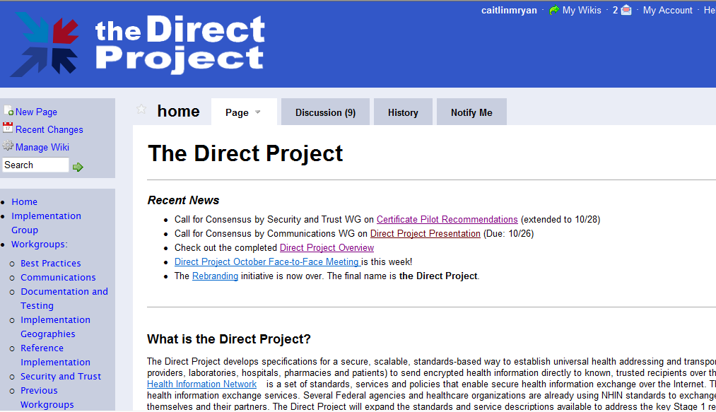
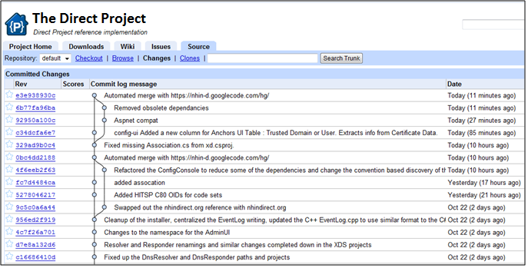
Direct Project The Process
Direct standards and specifications are developed by a group of public-private stakeholders. Weekly teleconferences and periodic face-to-face meetings facilitate active collaboration.
Direct Project Output:
Standards and Service Definitions
Implementation Guides
Reference Implementation
Pilot project testing and real-world implementation
Vendors incorporate reference implementation into HIT products
Wide-scale adoption of Direct standards by late 2012
First phase grounded in real-world pilot projects implemented by early 2011
Incorporation of HITPC, HITSC, and ONC policy guidance

Slide 10
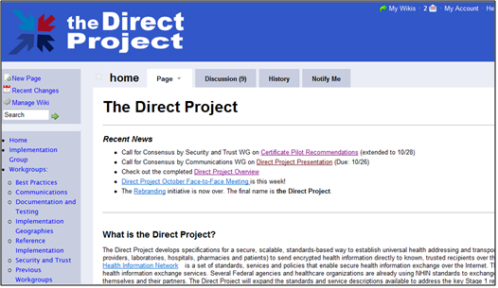
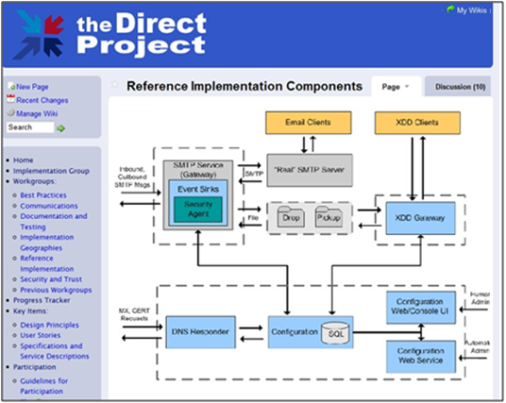
Direct Project Open and Transparent Collaboration

Slide 11
Direct Project High quality open source libraries
The history of the Internet shows the power of permissively licensed open source in driving standardization:
TCP/IP: Berkeley TCP/IP stack
DNS: BIND
HTTP: Apache
Successful open standards have easily accessible high-quality libraries trivially available to developers, including high quality documentation
A key deliverable of Direct Project is a BSD-licensed software stack enabling:
Client-side connectivity, for EHRs, EHR Modules, PHRs, etc. and
Server-side connectivity for “out of the box” HIOs and Health Information Service Providers (HISPs)

Slide 12
Direct Project High-level Project Plan
Activity
Standards and Specification Development
Real-world Implementation
Regulatory
Policy
Immediate
Next 90 Days
Short Term
3 to 9 months
Long Term
9 to 36 months
Aug 2010
Sept 2010
Oct 2010
Nov 2010
Dec 2010
1st Q 2011
2011
2012-2013
Draft Specification Complete
Transition to an SDO
Ongoing Maintenance
Initial Pilot Implementation
Expansion
of Pilots
Wide-Scale Deployment
Evaluation by HITSC
Evaluation for inclusion and ONC Endorsement
HITPC Tiger Team Framework and Policy Review
Feedback to Nationwide Health Information Network Governance
Feedback on initial lessons learned
Ongoing Review and Feedback
Immediate Initiatives
Short Term Initiatives
Long Term Initiatives

Slide 13
Direct Project Real-world Implementation
Direct Project will be demonstrated in real-world pilots across the country
Rhode Island Quality Institute (RI)
VisionShare (MN)
MedAllies (NY)
Redwood MedNet (CA)
Medical Professional Services (CT)
VisionShare (OK)
CareSpark (TN)
Direct Project is architected for rapid adoption by:
Thousands of hospitals
Hundreds of thousands of physicians
Millions of providers
Tens (or hundreds?) of millions of patients
Many other stakeholders in healthcare

Slide 14
Direct Project Four Steps to Direct
Successful implementation and adoption of Direct relies on four dominoes.
1
2
3
4
Reference Implementation
Pilot Demonstrations
Vendor Adoption
Policy Guidance
Reference Implementation: Solid, simple set of code and strong documentation.
Pilot Demonstrations: Successful incorporation of reference implementation in select regions to learn from pilot experience for broader standards adoption.
Vendor Adoption: Base interfaces available for purchase and code and software installed in all HIT exchange products.
Policy Guidance: Universal addressing is credible and security and privacy issues have established guidance.

Slide 15
Direct Project Questions?

